Slide 1
Mobility and sustainability
How sustainable will your Erasmus experience be?
Notes:
These instructions can also be found in the Green Erasmus Handbook for sustainable internationalisation, accessible through the Green Erasmus website results section (https://project.greenerasmus.org/documents/GE-handbook-HEIs.pdf), and downloadable as a separate document in the same section of the Green Erasmus website (https://project.greenerasmus.org/documents/GE-workshop-instructions.pdf).
Slides 1-4 (3 min)
Introduce the session by going through the objectives of the workshop and the agenda.
Mention that the session is an introduction to sustainability and aims to give some food for thought in relation to what students should consider when they are on mobility, rather than it being an exhaustive list of actions.
Mention that Green Erasmus is an Erasmus+ funded project that strives to improve the environmental sustainability of the Erasmus+ Programme and raise awareness across the European Higher Education sector about the importance of sustainable internationalisation. The project is coordinated by the Erasmus Student Network (ESN)
Mention why sustainability is important to your institution.

Slide 2
By the end of this session, you will: 1. Understand the environmental impact of your lifestyle 2. Gain a good level of understanding of actions that you can take to be more environmentally sustainable when undertaking mobility 3. Build confidence in communicating sustainability actions and behaviours to your friends and peers when on mobility
4. Be able to have a positive impact on the community through increased sustainability literacy
Notes:
Check slide 1

Slide 3
Agenda
Welcome
Introduction to sustainability and mobility
Taking action
Mobility choices
Consumption
Energy
Recycling and waste management
Next steps
[Breaks are built in but feel free to take as needed (e.g. for toilet, prayer, emergencies)]
Notes:
Check Slide 1

Slide 4
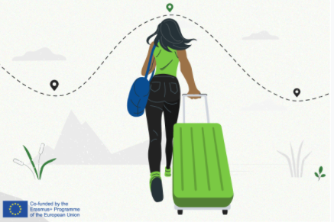
Welcome and introductions
Notes:
Check Slide 1

Slide 5
Where are you travelling for your Erasmus mobility and how are you planning on getting there?
Notes:
Slide 5 (3 min)
ACTIVITY:
As an optional ice-breaker exercise, and to get students to talk, ease in by asking where they are traveling for Erasmus and what mode of transport they plan to use (you can do this as a verbal exercise or by using slido).
As a follow up question, ask your students how they plan to travel/how they travelled to their mobility destination
NOTE: adjust this slide if you are holding the workshop for incoming students

Slide 6
The Erasmus programme has benefited more than 9 million young people since its inception and contributed to a more integrated and inclusive Europe. It has however also contributed to increased air traffic and led to other negative sustainability impacts.
Notes:
Slide 6 (1 min)
READ THE SLIDE.
Mention that even though the Erasmus programme has been very successful, it does have significant environmental impacts due to the carbon footprint associated with air travel – over ¾ of students travel to their destination by plane according to research by Green Erasmus with 10,000 students carried out in 2021

Slide 7
What does sustainability mean to you?
Share your understanding so we can create a word cloud
Link:
Notes:
Slide 7 (3 min)
ACTIVITY:
Ask students what is the first thing that comes to mind when they think about sustainability
You can either do this as a verbal exercise where students feedback or use an online tool such as slido to form a word cloud (we recommend the latter)
Talk through the most frequently mentioned words/associations.

Slide 8
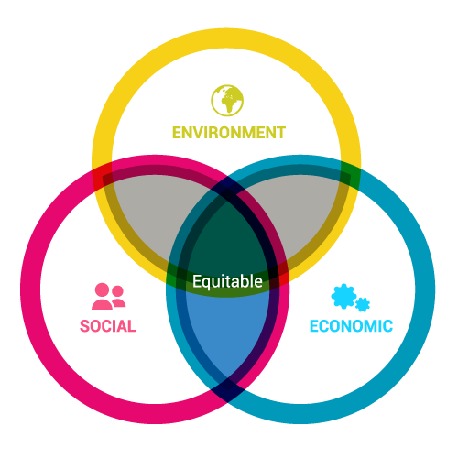
Sustainability and sustainable development
“…meeting the needs of the present without compromising the ability of future generations to meet their own needs.”
-Brundtland Commission
1987
Notes:
Slide 8 (1 min)
Describe what we mean by sustainability and sustainable development. You can focus on what your understanding of sustainable development is (there is no one clear definition) linking back to the responses that students gave in the previous slide.
Example response:
You will probably have heard the phrase sustainability or perhaps terminology such as sustainable energy, and this has evolved from the concept of sustainable development that was originally defined in a United Nations report.
This is just one definition used to speak about sustainability and can be engaged with critically and expanded upon as increasingly sustainability is being realised and recognised to include social justice too.
We need to look at social, economic and social issues for something to be sustainable but depending on the situation, there may be a need to emphasise certain issues more than others to ensure equity.
The term sustainable development helps us to think about using resources mindfully.
Within and outside of that it helps us to think about economic, social and environmental causes and impacts.
It may not be perfect but this is a global definition for sustainable development agreed by UN member states, with definitions shifting and changing due to context and time.

Slide 9
From our research*, one of the main reasons students get involved in sustainability action within Europe is to take action on climate change
What does the climate crisis mean to you?
*SOS-UK campaign surveys 2019-20
Notes:
Slide 9 (3 min)
Mention that throughout Europe students are involved in sustainability campaigns because they want to take action on the climate crisis.
ACTIVITY:
Verbal exercise - Ask students what does climate crisis mean to them?
Guide questions if needed:
What impacts have you seen/experienced?
How does reading about the climate crisis make you feel?
Are there particular things about climate change that you want to learn more about?
Ask them to share on key thing from their discussion afterwards to the wider group.

Slide 10
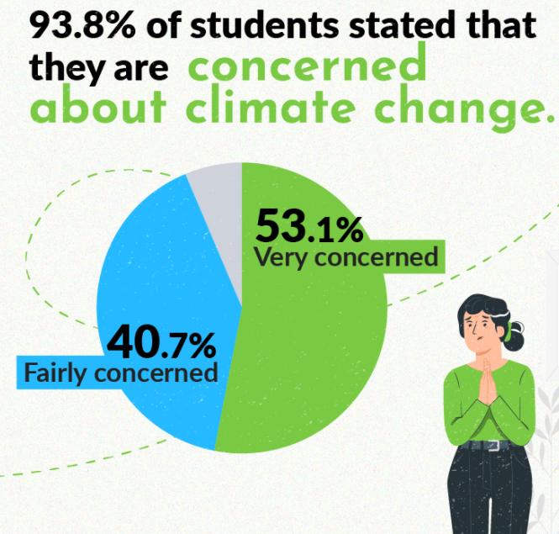
Notes:
Slide 10 (1 min)
READ THE SLIDE.
Mention that this data is from a survey conducted with 10,000 valid responses from Erasmus students in 2021. 7,776 answers were used in the analysis after data clearance. https://greenerasmus.org/documents/GE-report.pdf

Slide 11
Education and sustainability
Why should universities and education institutions be more sustainable?
As public institutions, universities and colleges have a moral obligation to act in the best interest of society.
This includes supporting students to develop into responsible, resilient citizens who can not just cope in our changing world, but thrive, and support others, including future generations, to thrive alongside them.
Notes:
Slide 11 (3 min)
ACTIVITY:
Ask the question ‘why should universities and education institutions be more sustainable?’ and encourage students to respond.
AFTERWARDS you can say: “Our world is changing; the climate crisis and its social, environmental and political consequences are propelling this change. Students will now graduate into a world that looks a lot different to the world older generations graduated into.
*READ SLIDE*

Slide 12
Importance of [university name] taking sustainable action
Notes:
Slide 12 (3 min)
OPTIONAL: Use this slide to say why it is important for your university to be taking action on climate change if you have concrete examples

Slide 13
‘Action is the antidote to despair’ Joan Boaz
Notes:
Slide 13 (1 min)
READ THE SLIDE.
Joan Baez is an American artist and activist.
Offer your own commentary on the quote or ask students what they think

Slide 14
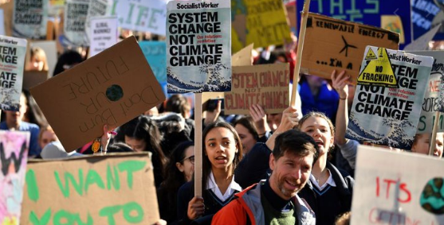
Personal action vs. system change
What are their benefits?
Notes:
Slide 14-15 (3 min)
Explain personal actions and system change (systems change being about action taken by institutions and governments). Feel free to watch the video from slide 15 prior to running the session if you are not sure how to articulate this (https://www.youtube.com/watch?v=S45266oIm58)
ACTIVITY:
Ask student to discuss briefly the benefits of each (either in small groups or together as a class)
There is a link between both e.g. as an individual you can help campaign for system change, and you also have power as a consumer e.g. to choose more ethical banks or support environmentally friendly businesses.
Explain who Greta Thunberg is (Swedish youth activist who started the Fridays for the Future movement).

Slide 15
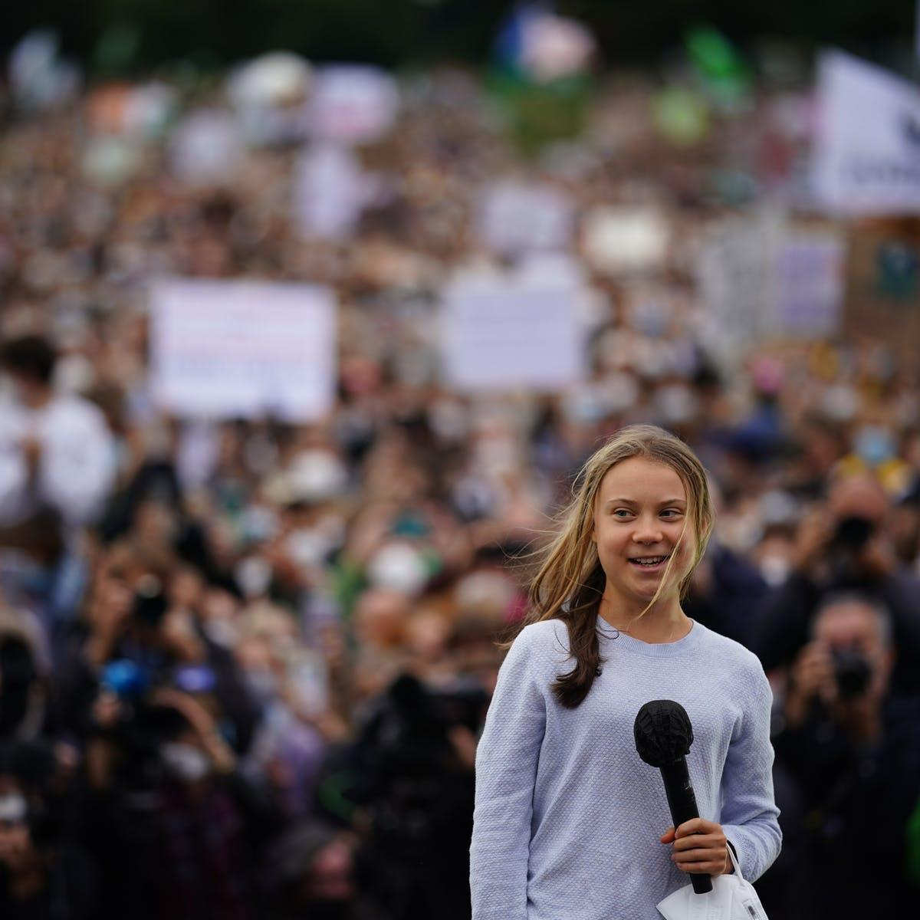
Personal action and systems change are connected
“The point is to create an opinion…you reduce your own carbon footprint and also send a signal to other people that the climate crisis is a real thing and that helps push a political movement.”
Greta Thunberg
Greta Thunberg in Berlin, September 2021. Clemens Bilan / EPA
Notes:
Check Slide 14

Slide 16
https://www.youtube.com/watch?v=S45266oIm58
Notes:
Slide 16 (7 min)
ACTIVITY:
Play the video on the slide that talks about system change vs personal action.
Ask students for their reflections on systemic vs personal change.

Slide 17
Taking personal action
Notes:
Slide 17 (1 min)
Mention that even though in the previous section we talked about systems change vs personal action, the rest of session is going to focus on individual action that can be taken to be more sustainable. This doesn’t mean that systems change is less important – it is!

Slide 18
When on Erasmus mobility, there are many actions you can take to be more sustainable and reduce your negative environmental impact
During today’s training, we will focus on 4 main areas:
Travel choices
Buying (or not!) choices
Energy usage
Recycling and waste management
Our suggestions are not exhaustive, they are there for you to consider your actions and give you some food for thought
Notes:
Slide 18 (2 min)
Explain that there are many actions that students can take when on their mobility (and everyday life!) to be more sustainable.
There are many different areas of their lifestyle that they can change, and for the purposes of this session we will be focusing on mobility choices, buying choices, energy usage, and recycling and waste management.
This doesn’t mean that there aren’t other areas of their lives that they can change.

Slide 19
Travel
Notes:
Slide 19-20 (2 min)
Mention that the first area that we will be focusing on is travel choices, as this was one of the main areas that was noted as part of the Green Erasmus survey in terms of mobility behaviour.
Describe the image on the slide 22– mention that in general flights have some of the highest carbon emissions per passenger per km travelled. Mention that there is some nuance to be considered – for example travelling by car, just by yourself, can emit more carbon per kilometer (also there is variation in terms of types of energy car is using etc).

Slide 20
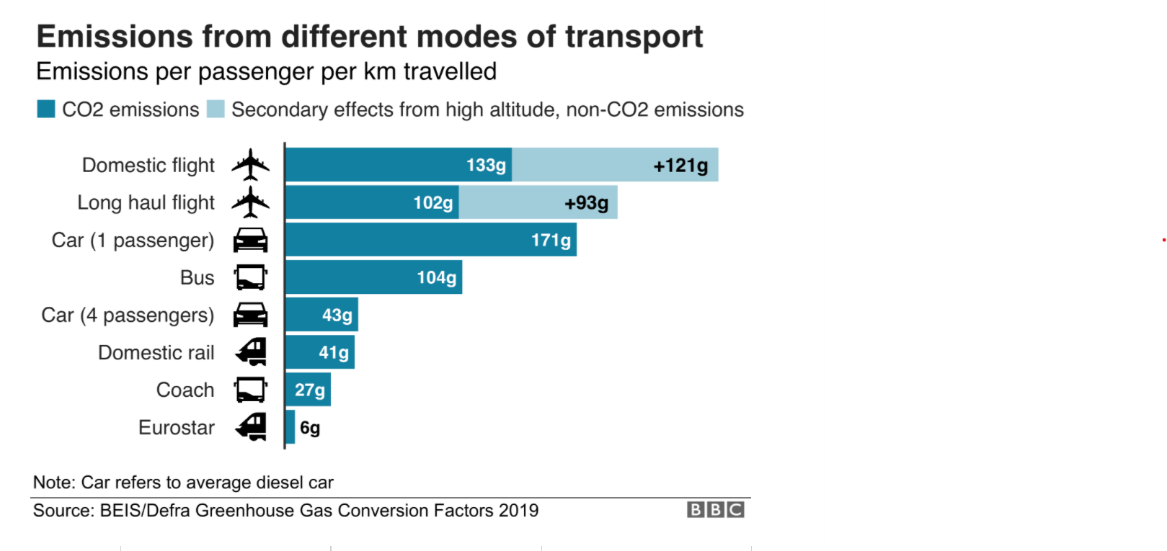
Notes:
Check Slide 19

Slide 21
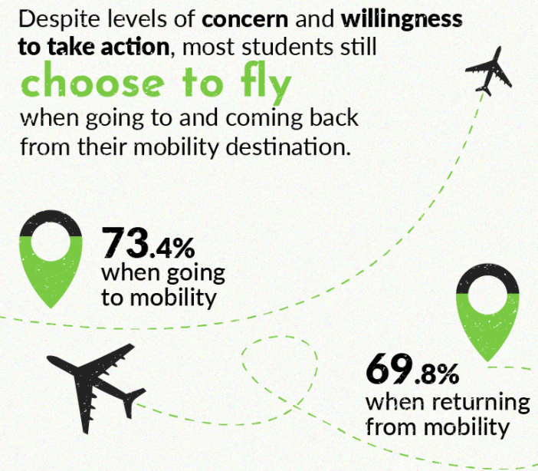
Notes:
Slide 21 (5 min)
Mention that according to the survey carried out with 10k Erasmus students in 2021 by Green Erasmus, ¾ of students travel to and from their mobility by plane.
ACTIVITY:
As an optional activity, you can ask students are they surprised by this statistic and why do they think the statistic is so high. Ask the students why do the mostly travel by plane.

Slide 22
What does your relationship to air travel look like?
Do you fly for work?
Do you fly to see family?
Do you fly to explore the world?
What benefits does air travel give you?
Is air travel your first choice of mode of transport?
How does air travel make you feel?
Notes:
Slide 22 (5 min)
ACTIVITY:
Ask students to break out into groups and discuss the following questions.
Ask students to feedback to the group what the discussed.

Slide 23
Air travel has big environmental impacts
Air travel is a carbon intensive form of travel
Demand is expected to rise if we remain doing “business as usual”
Double from 2016 to 2035
If left unchecked, what percentage of our global carbon emissions will air travel account for by 2050?
Technological fixes are tricky
Carbon offsetting
Biofuels
Batteries
Notes:
Slide 23 (5 min)
READ THE SLIDE
Further explanation/ notes you may want to use:
Sometimes we can’t avoid a flight!
Minimise layovers:
Shorthaul flights are particularly carbon intensive per unit of distance travelled
Travel economy class, why?
If you are trying to mitigate the impact of climate change you could donate to community-building or disaster relief efforts rather than an initiative as murky as carbon offsetting. If we are to spend money on carbon offsetting, we should invest in these schemes in addition to reducing air travel, rather than as a way to continue travelling as we please.
Challenge the idea that air travel represents success and global outlooks.

Slide 24
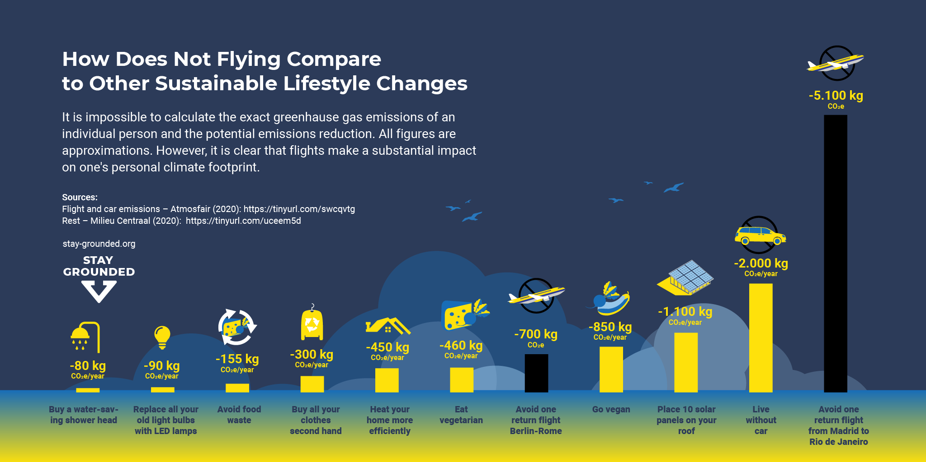
Notes:
Slide 24-25 (5 min)
Mention that flying is one of the biggest contributors to our personal carbon footprint.
ACTIVITY:
Ask students to work out the carbon footprint of their journey to their Erasmus destination and ask them to they have any thoughts.

Slide 25
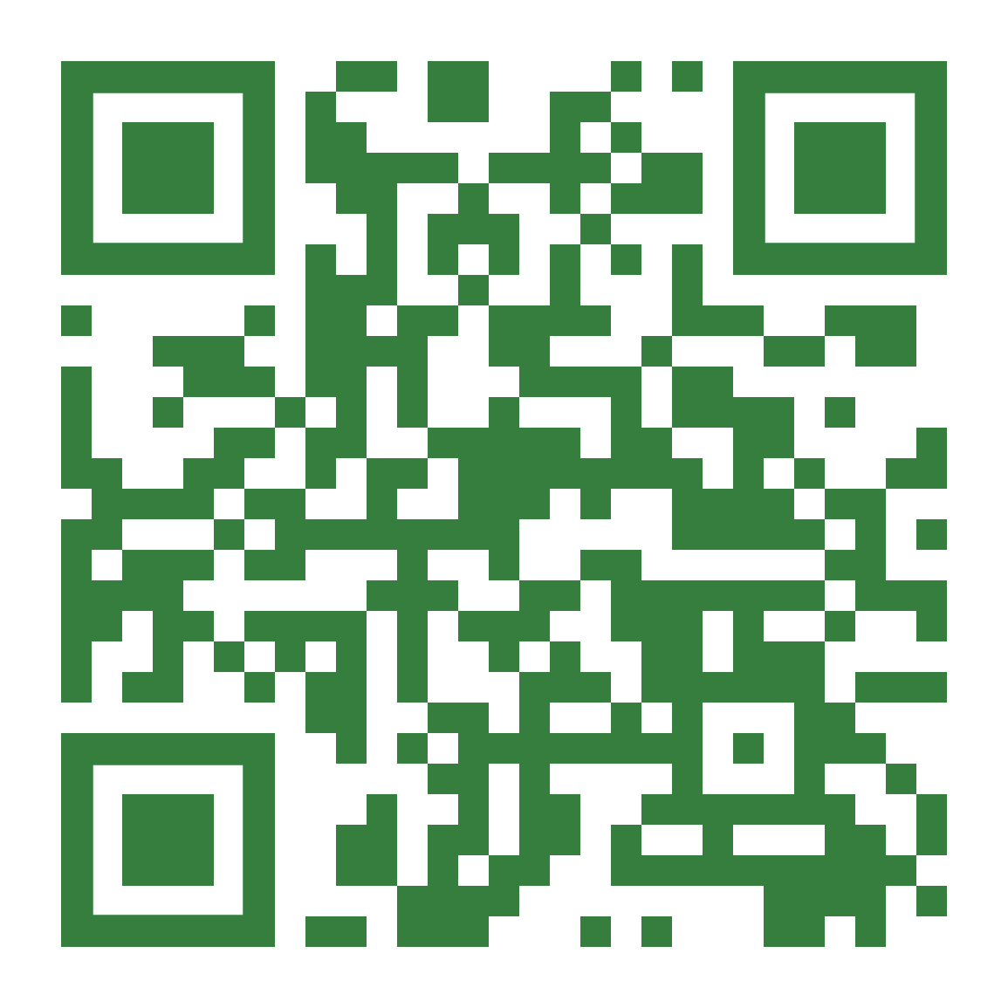
Work out the carbon footprint of the journey to your Erasmus destination
Notes:
Check Slide 24

Slide 26
Travelling better
Prioritise active and collective ground travel
Depending on where you’re located, train journeys may be faster!
Reflect on the necessity/benefits of your trip - how might you benefit from staying local?
When travelling within your place of mobility consider walking, cycling or public transport ahead of driving/taxi
Consider the location of your new accommodation – is it easily accessible on foot, bicycle or public transport?
Notes:
Slide 26 (5 min)
Either READ THE SLIDE or consider running an activity where you ask students in what way they could travel better when going on mobility or when they get there.

Slide 27
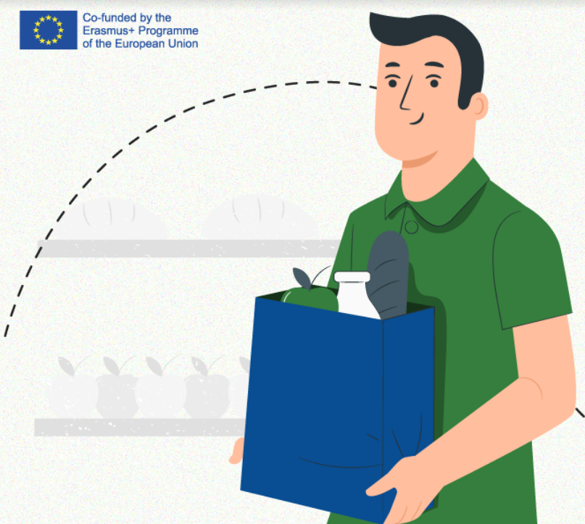
Buying (or not!) choices
Notes:
Slide 27-28 (2 min)
Mention that for the next section we will be talking about our purchasing choices and challenging the idea whether we in fact need to buy new things in the first place.
READ SLIDE 28

Slide 28
Consumption and production relies on the use of the natural environment and resources that inherently have an impact on the planet
Consider these statistics…
Source: https://www.un.org/sustainabledevelopment/sustainable-consumption-production/
Each year, an estimated one third of all food produced ends up rotting or spoiling due to poor transportation and harvesting practices.
If people worldwide switched to energy efficient light bulbs the world would save US$120 billion annually.
Should the global population reach 9.6 billion by 2050, the equivalent of almost three planets could be required to provide the natural resources needed to sustain current lifestyles.
Notes:
Check Slide 27

Slide 29
We all have possessions and items that we need or want in our daily lives
What categories of consumer items do you use on a regular basis – can you give some examples?
Food and drink
Clothing
Electronics
Books
Homeware
Toiletries and cosmetics
Sustainable consumption and production is about doing more and better with less.
Notes:
Slide 29 (5 min)
ACTIVITY
Ask students ‘what categories of consumer items do they use on a regular basis – and can they give an example?’. This can be done in small groups or as a large group.

Slide 30
Each item we have has an impact on the environment and people – be it production, usage, or disposal
When thinking about what to buy for/when at your mobility, what should you consider from the sustainability perspective?
Do you need to get it in the first place? If the answer is yes, consider:
Can you buy it second hand or borrow it?
Are there locally produced alternatives?
What are its sustainability credentials?
When thinking about what to buy for/when at your mobility, what should you consider from the sustainability perspective?
Notes:
Slide 30 (7 min)
ACTIVITY
Ask the questions:
‘When thinking about what to buy for/when at your mobility, what should you consider from the sustainability perspective’?
Do you need to get it in the first place? If the answer is yes, consider:
Can you buy it second hand or borrow it?
Are there locally produced alternatives?
What are its sustainability credentials?
When thinking about what to buy for/when at your mobility, what should you consider from the sustainability perspective?
The exercise can be done in small groups

Slide 31
BREAK
Notes:
Slide 31 (5 min)
BREAK - Suggested time – 5 mins

Slide 32
Energy usage
Notes:
Slide 32-33 (3 min)
Mention that the next section will focus on energy usage within the household.
Mention that according to Eurostat research (*https://ec.europa.eu/eurostat) , about a quarter of all energy used, is used by households.
ACTIVITY:
Ask students to think about how energy is used in the house. You can do this as a verbal exercise or through slido

Slide 33
We all use energy in our daily lives
According to Eurostat*, household energy usage represented about a quarter of final energy consumption in Europe. Energy usage leads to carbon emissions and the amount is related to how clean (renewable energy) or dirty (fossil fuels) the energy grid is (power stations)
Have a think, in what ways do we consume energy in our households? Will this be different when on mobility?
*https://ec.europa.eu/eurostat
Notes:
Check Slide 32

Slide 34
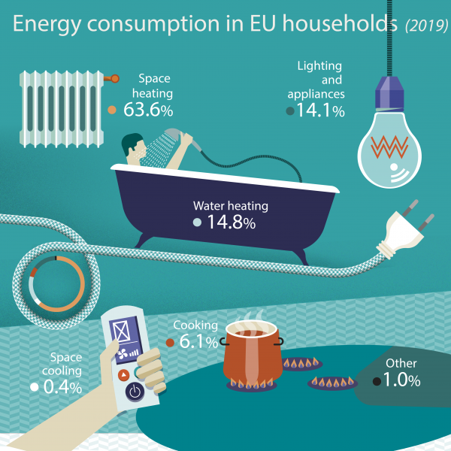
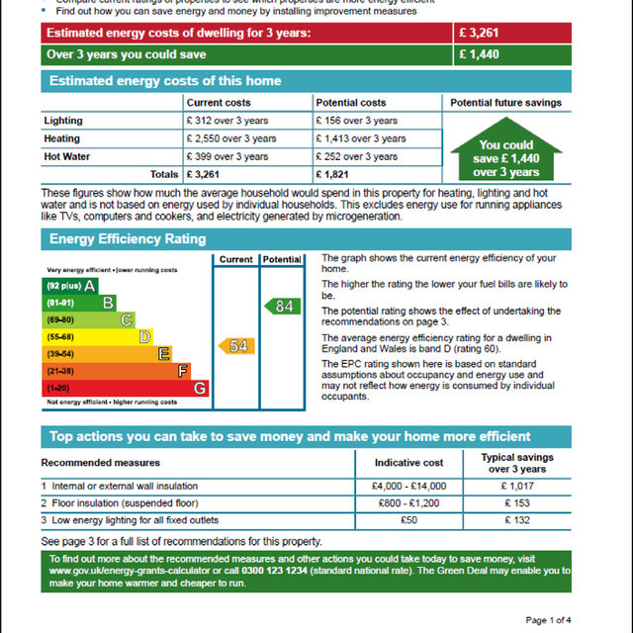
*https://ec.europa.eu/eurostat
Notes:
Slide 34 (2 min)
Describe the image, mentioning that the biggest consumption of energy within households is heating (nearly 2/3), followed by water heating & appliance use (c15%).
Mention that if we want to reduce our energy use, we should focus on these areas
Mention that when looking for accommodation they should consider that a high energy performance (A being highest) certification rating (EPC) in a cheaper house can sometimes be a false economy as they may end up paying more for energy bills. In most EU countries landlords have a legal obligation to give you the EPC before you sign your lease, so make sure to ask.

Slide 35
*Figure for four-person household. Source: Energy Saving Trust (https://energysavingtrust.org.uk/)
Notes:
Slide 35 (2 min)
Describe the slide showing the ways in which students can save energy in their households – you can read out some specific statistics from the slide.

Slide 36
Further suggested ways to reduce energy wastage within your household
Buy energy efficient appliances. The better the rating, the less the appliances will cost to use.
Put a lid on your pan when cooking. It cooks food quicker and reduces condensation.
Defrost your freezer. It makes it run more efficiently.
Wash clothes at lower temperatures. 30C is fine for most clothes.
Use your smart meter to see where you use the most energy and then take action to reduce it
Close curtains and windows to keep the heat in.
Fit simple low cost measures like “radiator panels” and “secondary glazing film”.
Put on layers to keep warm, before turning up the heating.
Understand your boiler settings and controls so you’re not heating an empty house.
Can you think of other actions?
Further info: https://www.sos-uk.org/sustainable-accommodation/energy-advice-for-renters
Notes:
Slide 36 (5 min)
READ THE SLIDE
Feel free to add any further energy saving measures from your experience.
ACTIVITY:
At the end of the slide, there is an optional activity for students to discuss (either as a group or in small groups) other ways that they can avoid energy wastage

Slide 37
Waste and recycling
Notes:
Slide 37 (1 min)
Mention that in the next section we will focus on waste and recycling

Slide 38
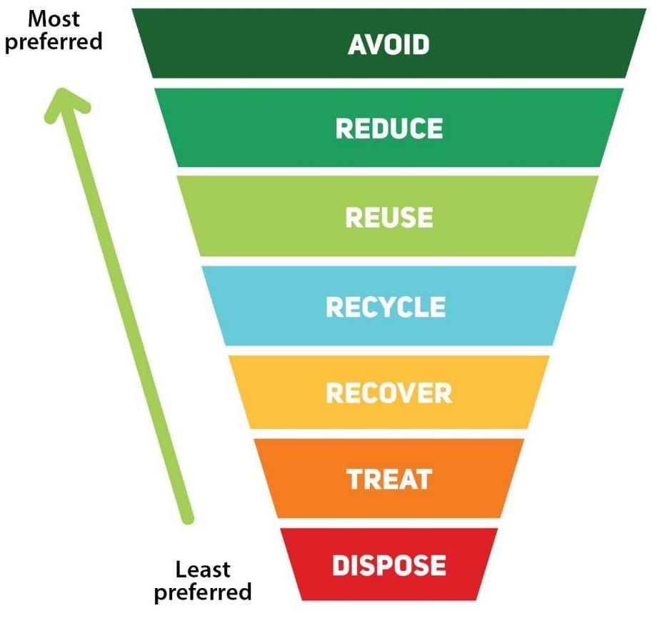
It is important that we reduce and avoid waste in the first place
Waste Reduction and Recycling:
Conserves natural resources
Reduces landfill waste & incineration
Protects people – often the poorest and most vulnerable suffer the consequences of mining and pollution
Protects ecosystems & wildlife
Saves energy – it takes 75% less energy to recycle a plastic bottle than make a new one!
Notes:
Slide 38 (2 min)
READ THE SLIDE
Describe the waste hierarchy (https://www.epa.nsw.gov.au/your-environment/recycling-and-reuse/warr-strategy/the-waste-hierarchy), mentioning that the best thing that we can do is to avoid waste in the first place (e.g. by buying less or getting products with less packaging).
Even though recycling is great and should be done, it is quite far down the waste hierarchy, and avoidance, reduction, and reuse should all come first.

Slide 39
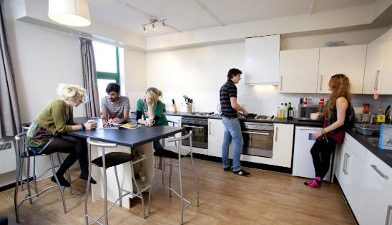
What do you currently do, or could be doing to avoid and reduce waste creation when on mobility? Why is this important?
Notes:
Slide 39 (5 min)
ACTIVITY:
Ask students:
What do you currently do, or could be doing to avoid and reduce waste creation when on mobility? Why is this important?
The exercise can be done as a group or with students divided into small groups.
Prompts can include:
Buying items with less packaging
Having a reusable cup, bottle or bag, so you don’t get a single use one every time you buy things
Buying only the food that you need to avoid food waste
Buying less items online (always comes with lots of packaging due to the parcel)
Borrowing items rather than buying them (especially if plan to use only once)
Instead of throwing items away consider mending them or giving to charity shops (if appropriate)
Optional further points to consider or discuss - is buying online better or going shopping in person?
Notes: Good overall resource: https://www.imperial.ac.uk/stories/protecting-nature/?mc_cid=8a6e63fe24&mc_eid=2376da3eea

Slide 40
Each city tends to have their own waste and recycling streams so it is important to familiarize yourself with local amenities - it may even vary district to district/building to building– don’t assume that the same system will be in place as there is in your home city.
If unsure, ask your landlord or letting agent.
Notes:
Slide 40 (2 min)
Read the slide

Slide 41
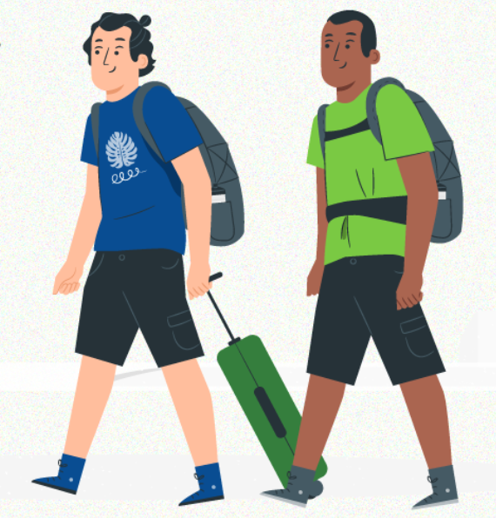
Next steps
Notes:
Slide 41 (3 min)
Mention that hopefully the workshop has given them some inspiration on what they could be doing to live more sustainably, saying this is not an exhaustive list.
ACTIVITY:
Ask students to write down a couple of things that they pledge to do when on mobility (suggestion to use slido)

Slide 42
What next can you do next?
Visit the Green Erasmus portal
Sign our petition calling for more support for sustainable travel
Notes:
Slide 42 (2 min)
Mention that students can visit the Green Erasmus portal to find out more about how they can make their mobility more sustainable (before, after and during). The portal includes tips and tricks to act sustainably in many aspects related to mobility, and useful resources for more information and get involved. For example, it features the On my way and Small Steps games and Green Erasmus Quiz to test students’ sustainability knowledge.
Mention that they are invited to sign the Green Erasmus a petition to increase the support for more sustainable travel through Erasmus+. Specificaly the petition ask EU institutions for
up to €250 for green travel, proportionate to distance covered
up to 7 days of additional individual support

Slide 43
Thank you for your attention - we hope that you enjoy your mobility!
Your name
Position/role
email@address.com
00 111 22 33 44
website: https://project.greenerasmus.org/

